Slide 1

Detecting Neutrinos via Active Radar Sounding
Richard Moser,
The University of Kansas
Notes:
Richard Moser
Working with
Dr. Dave Besson at KU and the Radio Echo Telescope experiment

Slide 2
Current detection methods
Optical: Icecube – detects Cherenkov radiation in the ice at the South Pole
Requires the Cherenkov light cone to actually “strike” the light sensors
Limits the density and/or size of the detector
Radio: ANITA – detects Askaryan radiation via a floating/flying antenna array above the South Pole
Also requires RF signal to “strike” the antennas
Antenna array is functionally one point
Provides a bearing and an angle but not a full “track” of the particle
And several more
Notes:
ANtarctic Impulsive Transient Antenna

Slide 3
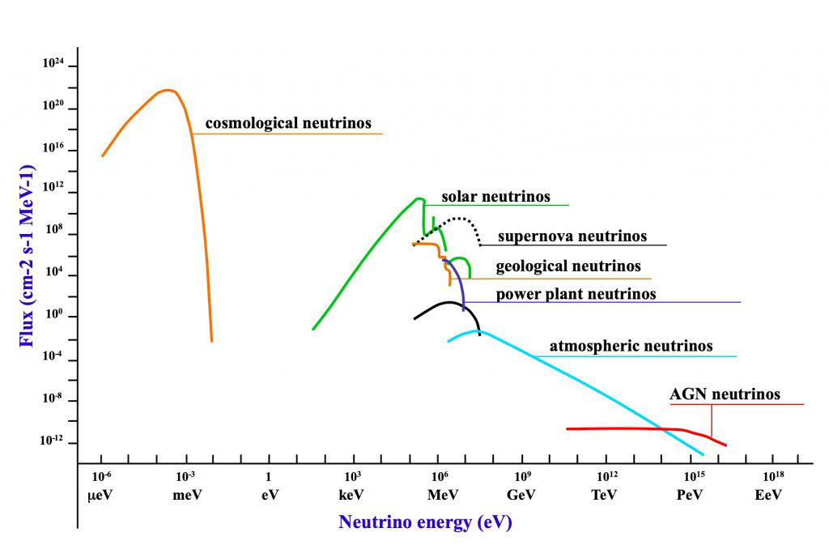
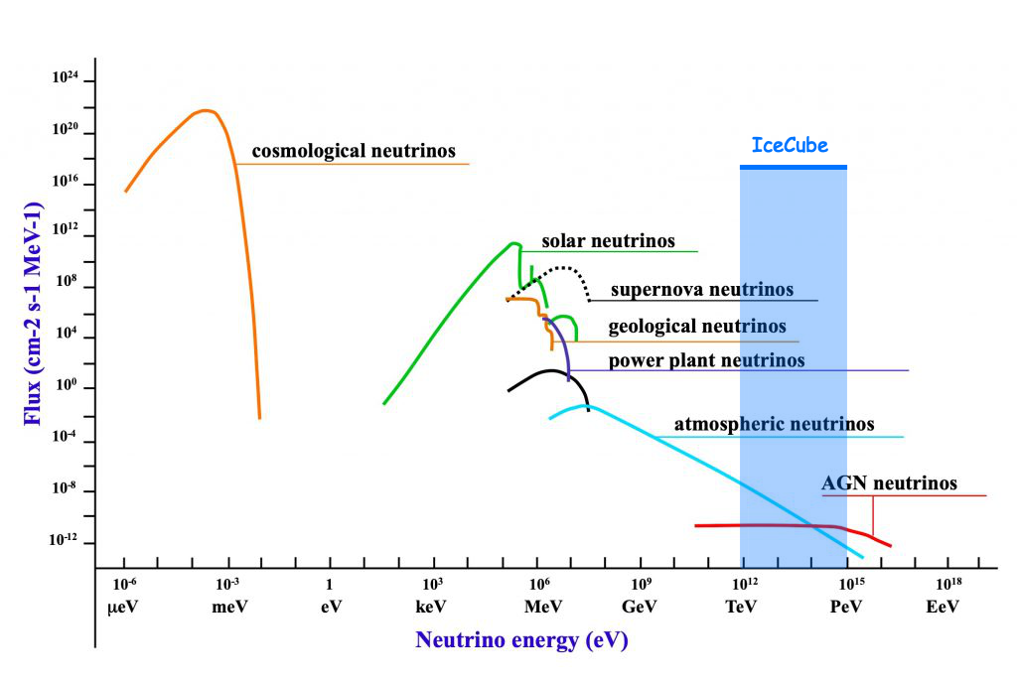
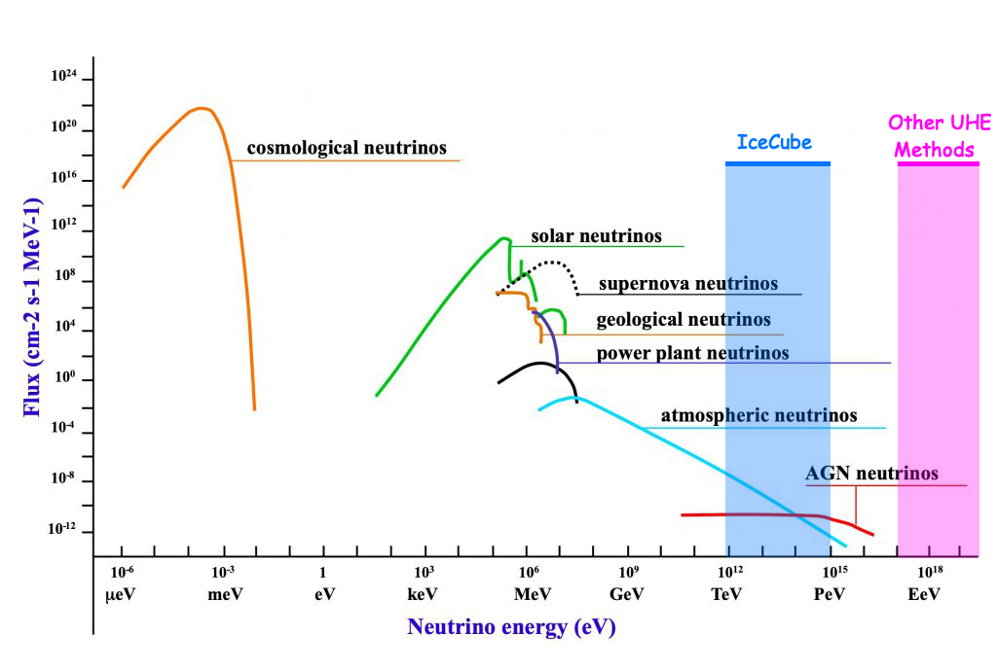
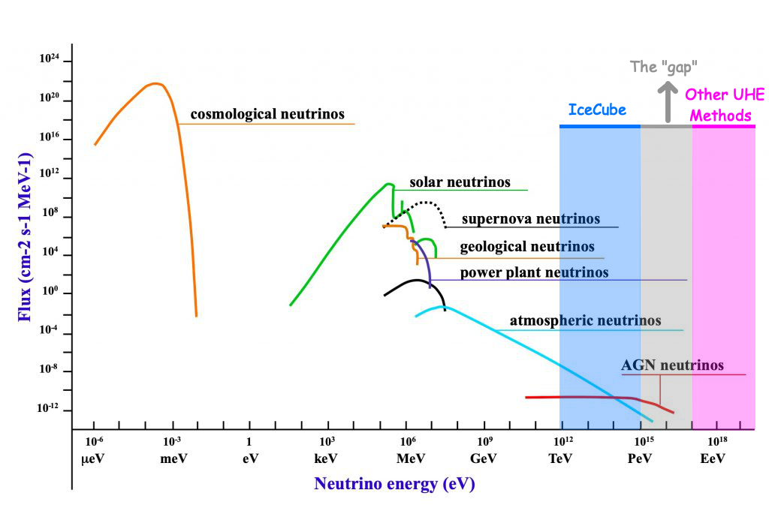
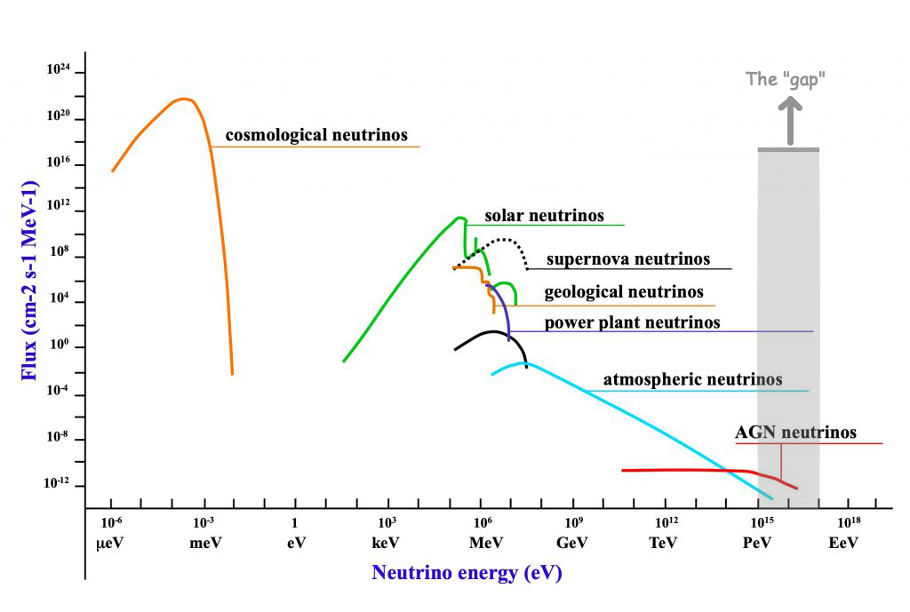
Notes:
UHE ≥ 10¹⁶ eV
Limiting factor of IceCube on the high end is flux or number of neutrinos per cubic unit of area. The energy is great enough that Icecube can see it but only if the neutrino hits the bullseye that is the detector.

Slide 4

The case for active radar emission based neutrino detection methods
“Sir, you were going 6.706e8 in a 35”
Notes:
How do we detect these ultra high speed particles? We almost need to set up a speed trap

Slide 5
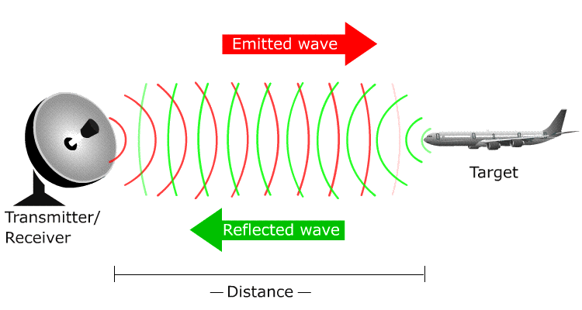
RADAR - RAdio Detection And Ranging
Requirements: Transmitter, target, and receiver

Slide 6
Neutrino Particle Shower Plasma
“As these shower particles traverse the interaction medium, they eject cold ionization electrons from atoms in the bulk, forming a tenuous particle-shower plasma (PSP), distinct from the energetic shower front particles responsible for ionization. For high incident particle energies (E ≥ 1 PeV, consistent with, and beyond, the experimental reach of the IceCube[1] experiment), this plasma will become dense enough to reflect incident radio-frequency (RF) radiation”
Particle-level model for radar based detection of high-energy neutrino cascades
S Prohira, D Besson: 2017
https://arxiv.org/abs/1710.02883
Notes:
This is the cardinal sin of powerpoint and I apologize. I leave it here in case anyone wants to read the full thing.
Greater than 1 PeV? Where have we seen that before?

Slide 7
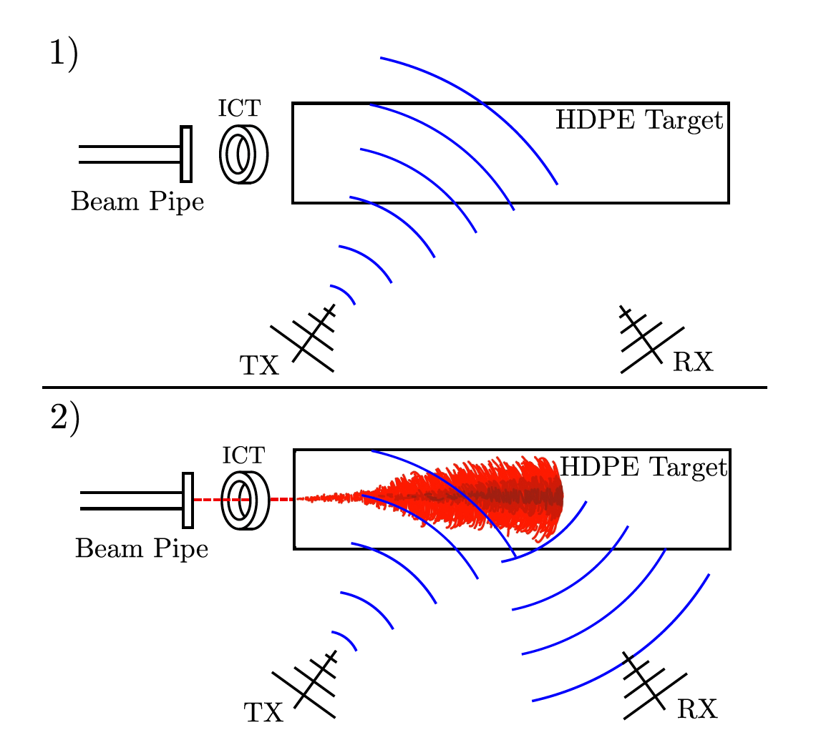
Experimental Data
Conducted at SLAC in May and October 2018
“We broadcast CW radio at a range of frequencies between 1 and 2.1 GHz and a range of amplitudes, using a signal generator, 50Wpower amplifier, and transmitting antenna (TX) toward a target of high-density polyethylene (HDPE), into which the electron beam was directed. Receiving antennas (RX) were also directed at this target to measure the radar reflection.”
Notes:
integrating current toroid (ICT) which gave a precise measurement
of the charge in each bunch

Slide 8
Notes:
At PeV and higher energies, the plasma becomes dense

Slide 9
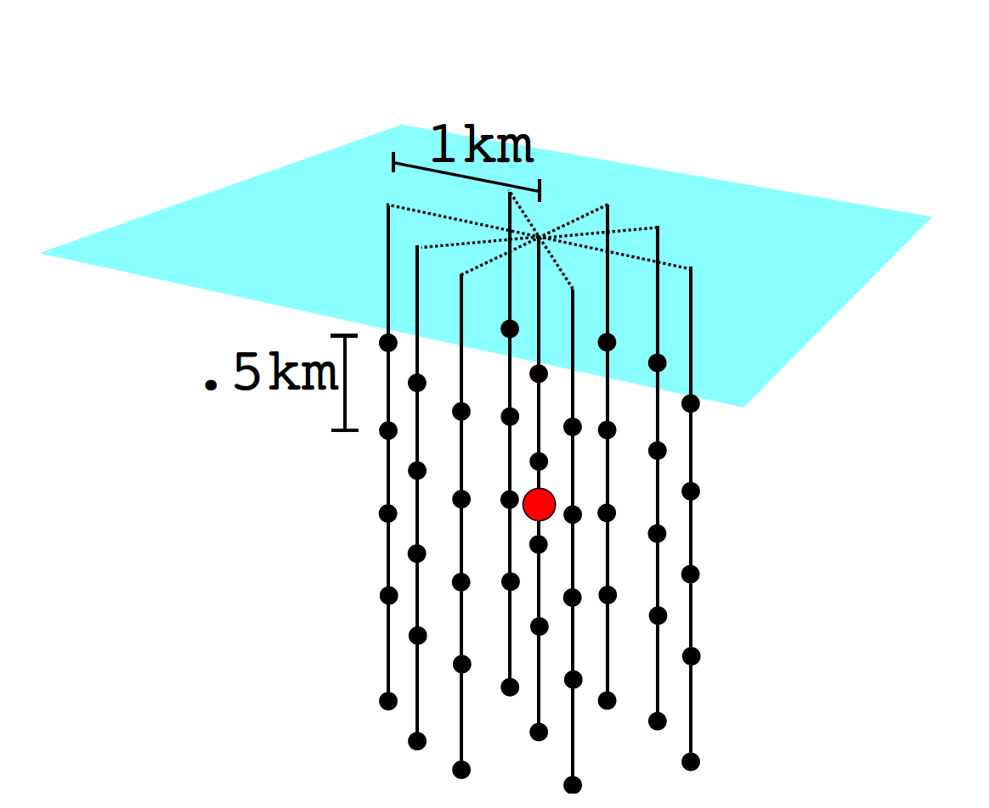
Example detector
Observation of Radar Echoes From High-Energy Particle Cascades
S. Prohira, K.D. de Vries, P. Allison, J. Beatty, D. Besson, A. Connolly, N. van Eijndhoven, C. Hast, C.-Y Kuo, U.A. Latif, T. Meures, J. Nam, A. Nozdrina, J.P. Ralston, Z. Riesen, C. Sbrocco, J. Torres, S. Wissel: 2019
https://arxiv.org/abs/1910.12830

Slide 10
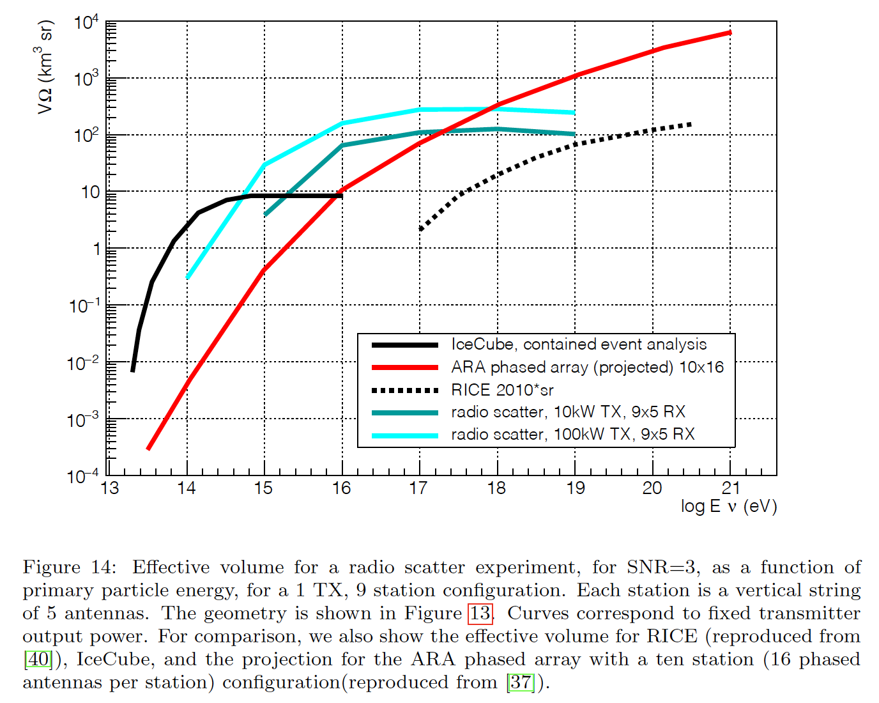
Effective array volume
Observation of Radar Echoes From High-Energy Particle Cascades
S. Prohira, K.D. de Vries, P. Allison, J. Beatty, D. Besson, A. Connolly, N. van Eijndhoven, C. Hast, C.-Y Kuo, U.A. Latif, T. Meures, J. Nam, A. Nozdrina, J.P. Ralston, Z. Riesen, C. Sbrocco, J. Torres, S. Wissel: 2019
https://arxiv.org/abs/1910.12830

Slide 11
Power
100 kW is the TX power of your average FM Radio station
Summer power: Solar (?)
A standard 100kw solar system is $130k to $200k
Snow build up on panels?
Winter Power: Wind (?)
a standard 100 kW wind turbine costs about $50k but I would *assume* several smaller modified (cold ready) turbines would be used
Maintenance?
Notes:
The Parker-Palpatine Conjunctive Power Principle: With unlimited power comes unlimited responsibility.

Slide 12
Advantages of active emission
Received signal strength scales with transmitter signal power, not just particle energy
Indirect particle detection
The “plane” doesn’t have to hit the receiver for the receiver to see it
Greater detection range = lower sensor density = larger array
Better anthropogenic and background noise rejection
Received signal should closely match transmitted signal
Continuous CW pulse – from transmitter in shadow zone
Active detection sensitivity should peak in the 10-100PeV range where other sensors are less effective
Notes:
The nice thing about radar is that the reflected signal you get back should be roughly the same as what you transmitted, it is the transformations to that signal that give you information about what they were reflected off of.

Slide 13

Radio Scatter
C++ and ROOT radio/particle simulation software
Used to simulate incident radio frequency Radiation from a particle shower and scattered signal
i.e. simulates shooting high speed plasma with a radar gun
Calculates with regard to and allows testing of:
Transmitter, particle, & reciever geometries
Antenna gain
Refraction properties in the medium (ice)

Slide 14
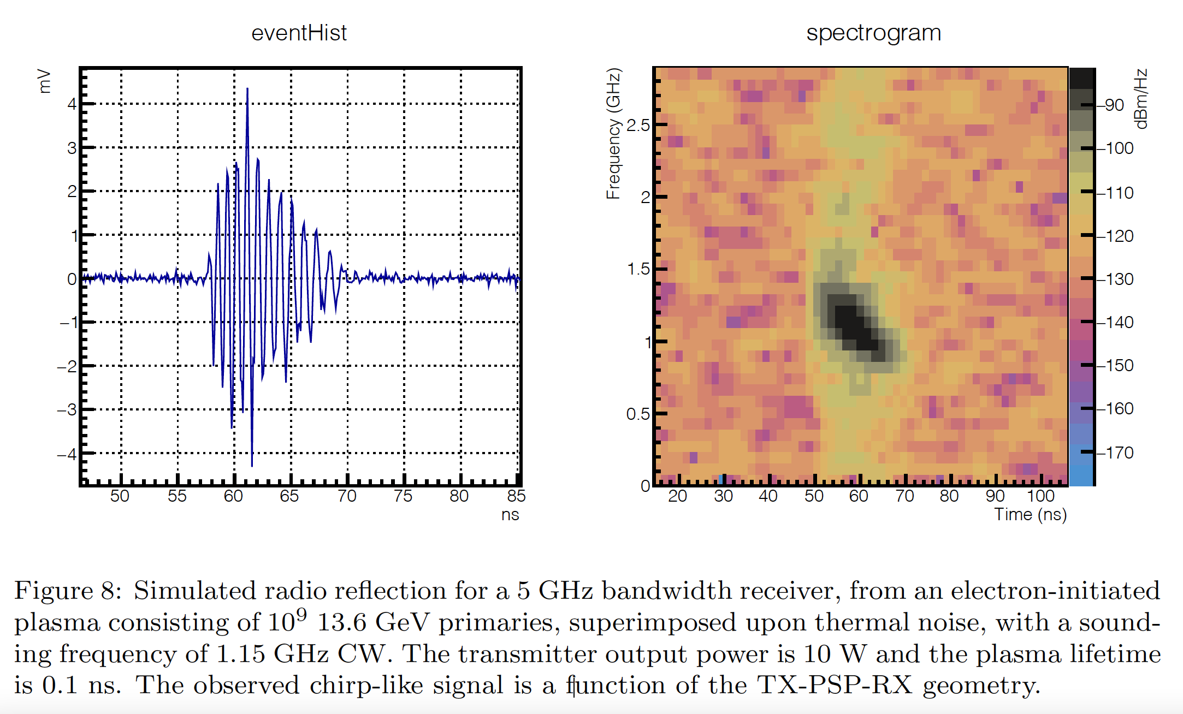
The ideal return
Particle-level model for radar based detection of high-energy neutrino cascades
S Prohira, D Besson: 2017
https://arxiv.org/abs/1710.02883
Notes:
In the radio talk a week ago I asked if this was even a useful way to plot the data. This is a prettied up plot of a better return. Notice that the waveform shows noise but the received signal rises out of it nicely. In the spectrogram, the chirp shows up relatively narrow and discrete from the surrounding background. The spectrogram plotting frequency, time, and intensity against one another is very useful for rapid qualitative recognition. This is how passive sonar data is interpreted in a time frequency LOFAR display (Low Frequency Analysis and Ranging). Why is it black though? i.e. low intensity?
Sidebar: if anyone wants me to talk offline (or in here) about why the rays trace like they do and why some of this stuff works I can do that. I say that only because a few people have asked or gotten me on that tangent and said “oh that makes sense now.”

Slide 15
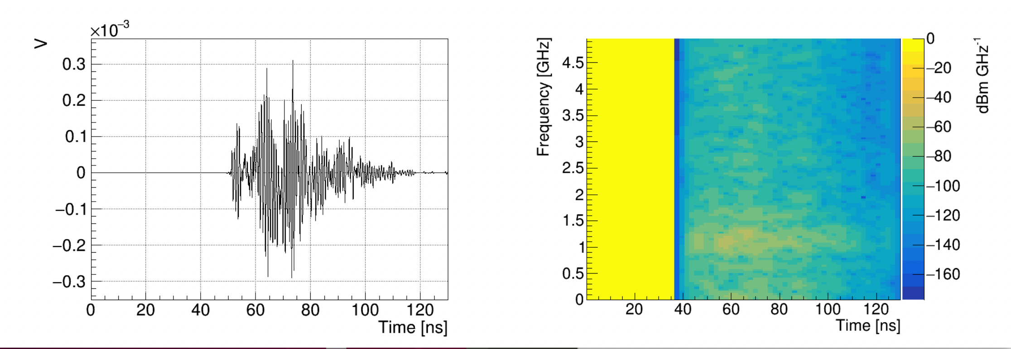
Early results
The issue: noise!
Notes:
On the left we see a clean, noiseless waveform reflected off of the digital plasma from the shower shower. On the right is a spectrogram which shows a wide swath. Oddly the swath starts at about 37 nanoseconds while the waveform pulse begins around 50ns from t-zero

Slide 16
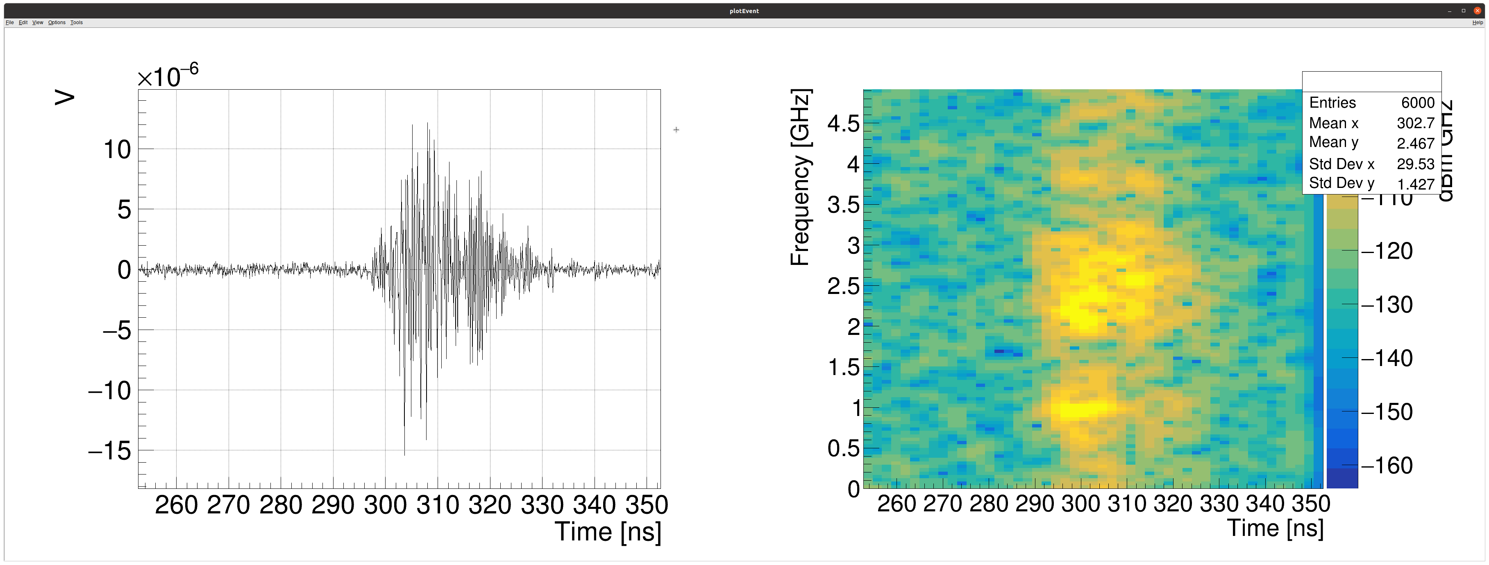
Closing in on ideal
Notes:
The issue was the noise generation process:

Slide 17
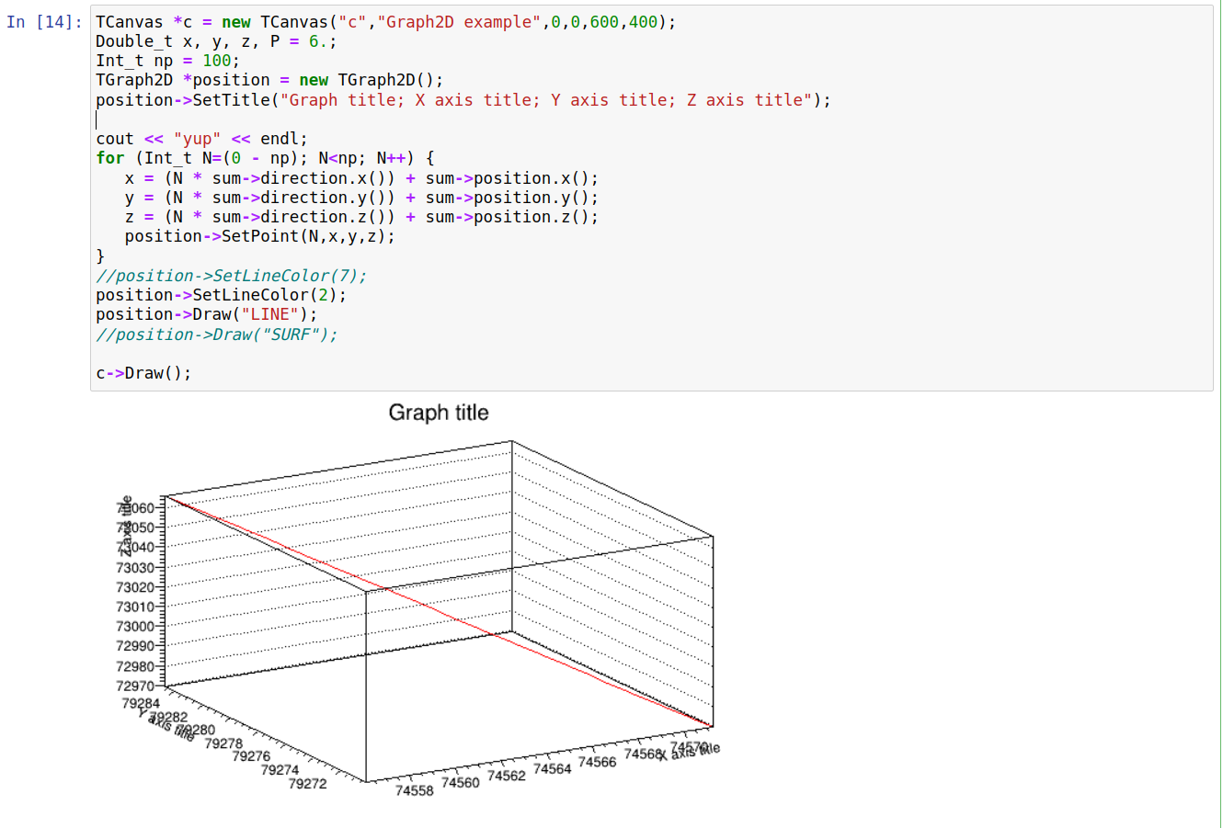
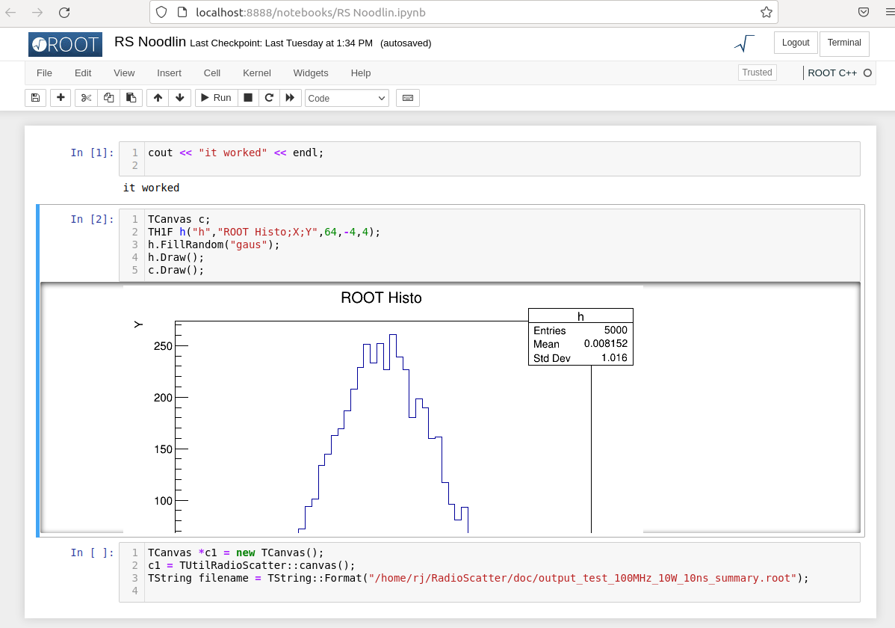
C++ ROOT Jupyter notebooks!

Slide 18
The path forward
Testing different geometries and power levels
Optimize settings for discreet chirps
Determine effective and efficient geometries
Finding new relationships within the data
ROOT, RadioScatter, and GEANT4 installation on KU computing cluster
Build it!
The University of Kansas will build a test pulser for the Radio Echo Telescope (RET) group

Slide 19
Info, data, chart sources
Particle-level model for radar based detection of high-energy neutrino cascades
S Prohira, D Besson: 2017
https://arxiv.org/abs/1710.02883
Observation of Radar Echoes From High-Energy Particle Cascades
S. Prohira, K.D. de Vries, P. Allison, J. Beatty, D. Besson, A. Connolly, N. van Eijndhoven, C. Hast, C.-Y Kuo, U.A. Latif, T. Meures, J. Nam, A. Nozdrina, J.P. Ralston, Z. Riesen, C. Sbrocco, J. Torres, S. Wissel: 2019
https://arxiv.org/abs/1910.12830
Research supported by EPSCoR T-2

Slide 20
Questions, Critiques, Complaints?

Slide 21
